Slide 1


Creating optimal schedule for Major league baseball
By: Eric Zuniga, Sam Wilson

Slide 2
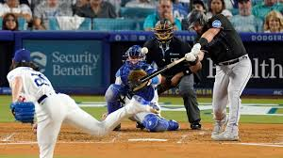
How Major League Baseball Does It
162 teams split between American and National league
6 divisions with 5 teams in each division
MLB Actual scheduling rules:
Every team plays all 15 teams in the opposite league
one 3 games series against 14 teams with splitting between home and away.
1 “rivalry” team gets a 4- game series 2 home and 2 away
Each team plays 52 games against teams in their own division 13 games against each of the 4 division rivals. With two 3 game series away, one 3 game series home and one 4 game series home.
Each team plays 64 games against other teams in their own league but different divisions. With one 3 game series away and one 3 game series home.
Teams play series of 3 to 4 games, not one-off games.
6-7 games per week, with 1-2 days off.
Every team must play 81 home and 81 away games.
Schedulers try to avoid coast to coast trips without rest days
Series against far team's East vs West Coast are usually grouped to reduce back and forth
They usually try to schedule ‘’prime time’’ games

Slide 3
How we did it
All 30 MLB teams are listed and grouped into 6 divisions
Each team plays exactly 54 games
Each team can play at most one game per day.
Each team plays no more than 6 games per week over any 8-day window
Each team must play at least 20 different opponents.
Teams within a division must play 13 times total.
One team hosts 7 games, the other hosts 6 games.

Slide 4
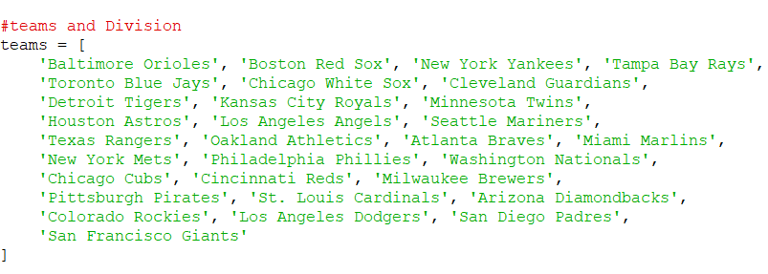
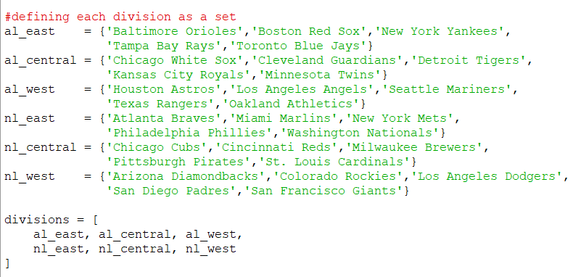
Variables

Slide 5
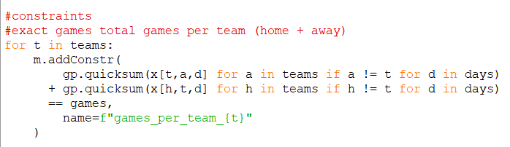
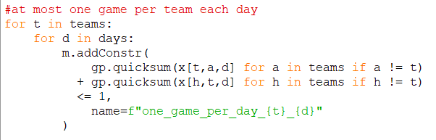
Constraints

Slide 6
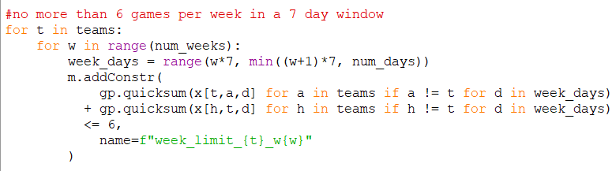
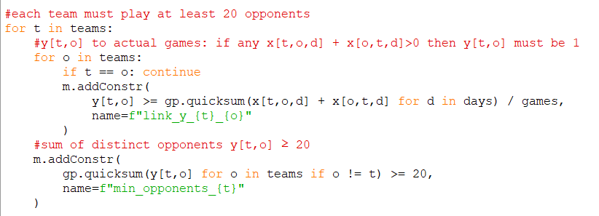
Constraints

Slide 7
Problems we ran into the code
Had to reduce the season from 162 to 54 games
Trying to add extra constraints like ”prime time” games
Equalized distance traveled in feasible

Slide 8
Optimal Schedule
2 Los Angeles Angels @ Texas Rangers
5 Houston Astros @ Texas Rangers
6 Seattle Mariners @ Texas Rangers
7 Texas Rangers @ Los Angeles Angels
8 Texas Rangers @ Houston Astros
10 Texas Rangers @ Oakland Athletics
11 Oakland Athletics @ Texas Rangers
12 Texas Rangers @ Houston Astros
13 Oakland Athletics @ Texas Rangers
15 Texas Rangers @ Houston Astros
16 Texas Rangers @ Los Angeles Angels
17 Oakland Athletics @ Texas Rangers
18 Oakland Athletics @ Texas Rangers
19 Texas Rangers @ Los Angeles Angels
20 Houston Astros @ Texas Rangers
22 Los Angeles Angels @ Texas Rangers
23 Texas Rangers @ Oakland Athletics

Slide 9
26 Texas Rangers @ Oakland Athletics
27 Houston Astros @ Texas Rangers
28 Houston Astros @ Texas Rangers
29 Texas Rangers @ Oakland Athletics
30 Texas Rangers @ Los Angeles Angels
31 Texas Rangers @ Oakland Athletics
32 Texas Rangers @ Los Angeles Angels
34 Texas Rangers @ Houston Astros
35 Texas Rangers @ Houston Astros
36 Oakland Athletics @ Texas Rangers
37 Texas Rangers @ Seattle Mariners
39 Texas Rangers @ Seattle Mariners

Slide 10
40 Seattle Mariners @ Texas Rangers
41 Los Angeles Angels @ Texas Rangers
42 Texas Rangers @ Seattle Mariners
43 Texas Rangers @ Houston Astros
44 Texas Rangers @ Seattle Mariners
46 Texas Rangers @ Los Angeles Angels
47 Texas Rangers @ Seattle Mariners
50 Texas Rangers @ Oakland Athletics
51 Texas Rangers @ Oakland Athletics
52 Houston Astros @ Texas Rangers
53 Texas Rangers @ Seattle Mariners
54 Seattle Mariners @ Texas Rangers

Slide 11
55 Texas Rangers @ Los Angeles Angels
56 Los Angeles Angels @ Texas Rangers
57 Oakland Athletics @ Texas Rangers
58 Texas Rangers @ Houston Astros
60 Los Angeles Angels @ Texas Rangers
61 Seattle Mariners @ Texas Rangers
63 Texas Rangers @ Colorado Rockies
64 Seattle Mariners @ Texas Rangers
66 Texas Rangers @ Seattle Mariners
67 Seattle Mariners @ Texas Rangers
68 Houston Astros @ Texas Rangers
70 Colorado Rockies @ Texas Rangers

Slide 12
Texas Rangers 2025 Schedule
1 Boston Red Sox @ Texas Rangers
5 Texas Rangers @ Cincinnati Reds
8 Tampa Bay Rays @ Texas Rangers
11 Texas Rangers @ Chicago Cubs
14 Texas Rangers @ Seattle Mariners
17 Los Angeles Angels @ Texas Rangers
20 Los Angeles Dodgers @ Texas Rangers
23 Texas Rangers @ Oakland Athletics
26 Texas Rangers @ San Francisco Giants
29 Oakland Athletics @ Texas Rangers
33 Seattle Mariners @ Texas Rangers

Slide 13
36 Texas Rangers @ Boston Red Sox
39 Texas Rangers @ Detroit Tigers
42 Colorado Rockies @ Texas Rangers
45 Houston Astros @ Texas Rangers
49 Texas Rangers @ New York Yankees
52 Texas Rangers @ Chicago White Sox
55 Toronto Blue Jays @ Texas Rangers
58 St. Louis Cardinals @ Texas Rangers
61 Texas Rangers @ Tampa Bay Rays
64 Texas Rangers @ Washington Nationals
67 Texas Rangers @ Minnesota Twins
70 Chicago White Sox @ Texas Rangers
73 Kansas City Royals @ Texas Rangers
76 Texas Rangers @ Pittsburgh Pirates

Slide 14
79 Texas Rangers @ Baltimore Orioles
82 Seattle Mariners @ Texas Rangers
85 Baltimore Orioles @ Texas Rangers
88 Texas Rangers @ San Diego Padres
91 Texas Rangers @ Los Angeles Angels
95 Texas Rangers @ Houston Astros
98 Detroit Tigers @ Texas Rangers
101 Oakland Athletics @ Texas Rangers
104 Atlanta Braves @ Texas Rangers
107 Texas Rangers @ Los Angeles Angels
111 Texas Rangers @ Seattle Mariners
115 New York Yankees @ Texas Rangers
118 Philadelphia Phillies @ Texas Rangers
121 Arizona Diamondbacks @ Texas Rangers

Slide 15
121 Arizona Diamondbacks @ Texas Rangers
124 Texas Rangers @ Toronto Blue Jays
127 Texas Rangers @ Kansas City Royals
131 Cleveland Guardians @ Texas Rangers
134 Los Angeles Angels @ Texas Rangers
137 Texas Rangers @ Oakland Athletics
140 Texas Rangers @ Arizona Diamondbacks
143 Houston Astros @ Texas Rangers
147 Milwaukee Brewers @ Texas Rangers
150 Texas Rangers @ New York Mets
153 Texas Rangers @ Houston Astros
157 Miami Marlins @ Texas Rangers
160 Minnesota Twins @ Texas Rangers
163 Texas Rangers @ Cleveland Guardians

Slide 16
Comparing to Actual
The total distance that the Texas Rangers in our code traveled was 32,925.2 miles.
2025 Texas Rangers schedule:
37,281 miles
Ranked 10th worst in the league for travel

Slide 17
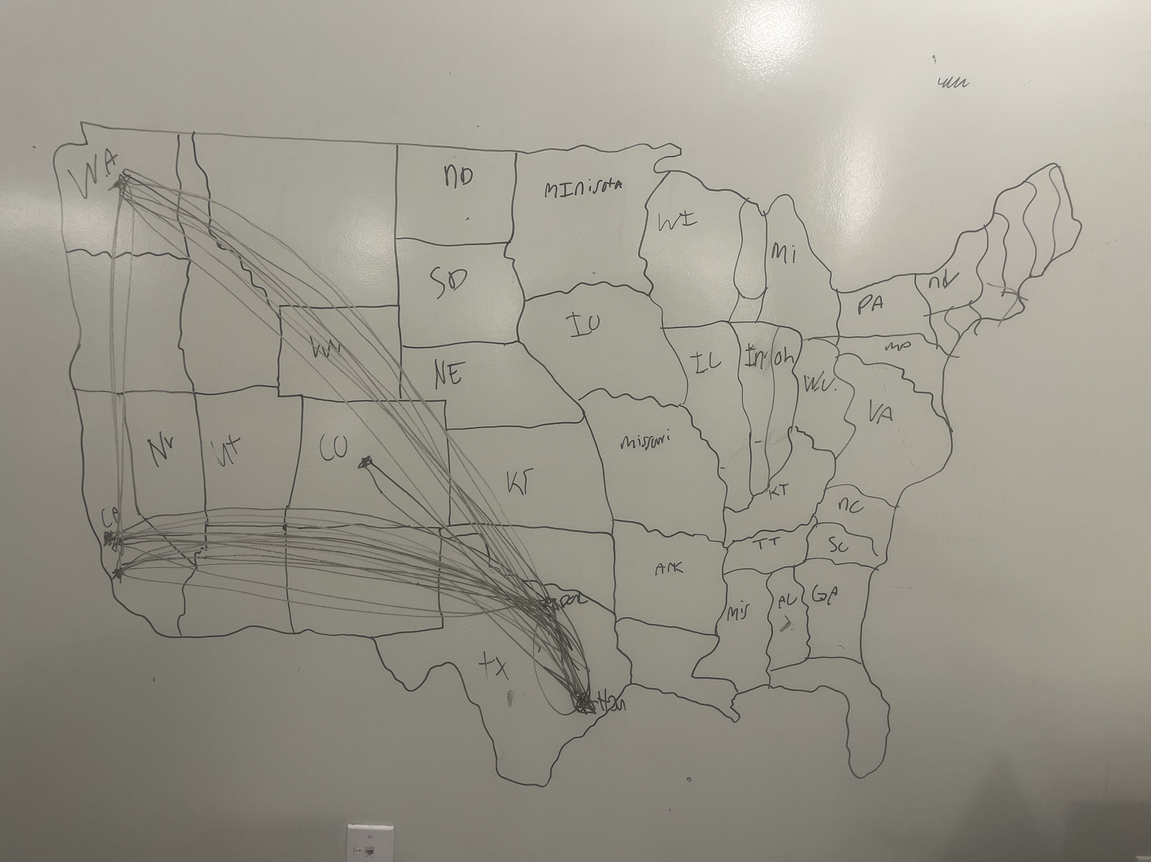
Map of where the Texas Rangers travelled in our code

Slide 18
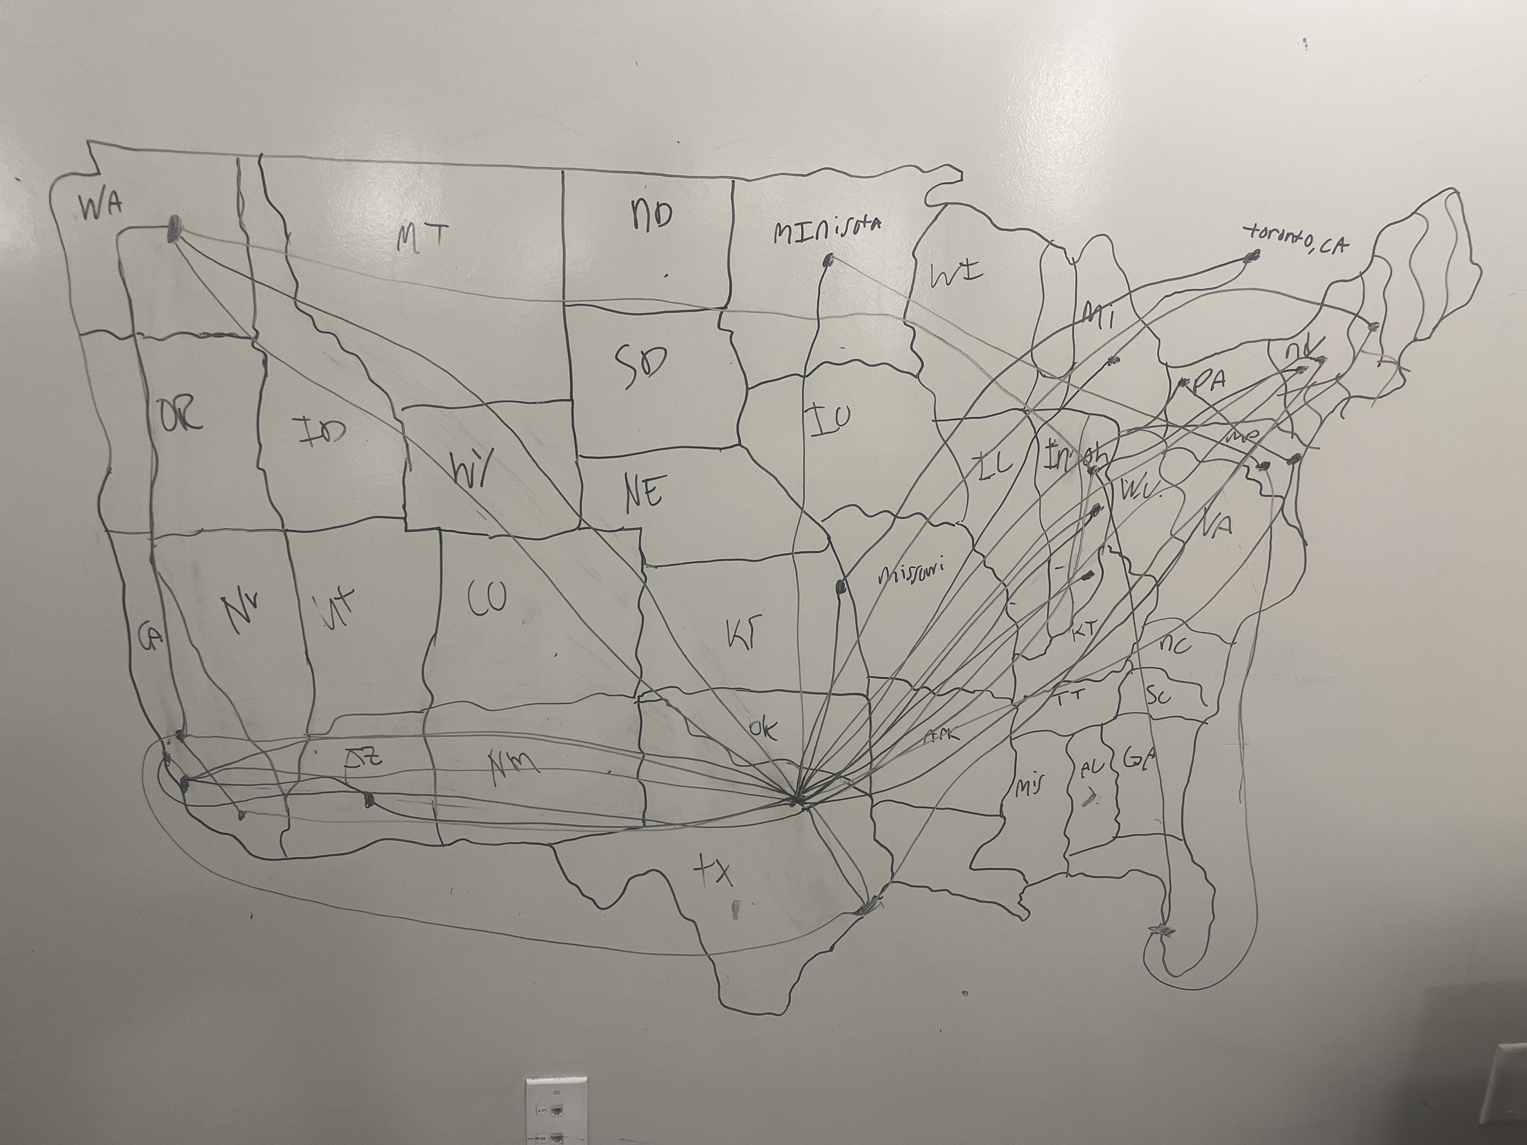
Map of where the Texas Rangers will travel in 2025

Slide 19

Is our schedule / minimized travel code optimal?

Slide 20
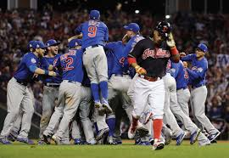
Ideas that we could add?

Slide 21

Q/A?

Slide 22
Sources:
https://cw33.com/texas-rangers/texas-rangers-mlb-season-travel/
https://www.mlb.com/rangers/schedule/2025-05

